Slide 1

TCP/IP Enablement for TPF
© 2005 American Express. All Rights Reserved.

Slide 2
AGENDA
Side-by-Side comparison of SNA and TCP/IP.
TCP/IP headers.
Program flows and record layouts.
What Happens at cycle-up?
Overview of sockets.
IP-trace tools.
Online trace tool – 74OTF.
Offline trace tool.
The data – streams versus messages.
Data collection.
What to do if there’s a problem.
Implementation risks.
Questions.

Slide 3
SNA vs. TCP/IP
Stratus devices are being replaced with GAN devices.
STRATUS
SNA
Merchants
CAS
GAN Complex
APSRV1
APSRV2
APSRV3
IP

Slide 4
SNA & TCP/IP MESSAGE FLOW
Authorization message from Stratus
Authorization message from GAN
Links inbound (YA8x)
Middleware Inbound (DU7x)
Links IP Inbound (YYxx)
CAS Applications (RA6x) (Parsing)
Links Outbound (ZA8x)
Links IP Outbound (YZxx)
Middleware Outbound (DV7x)
Response to Stratus
Response to GAN

Slide 5
NEW TABLES
CIST – Core Index Socket Table 4096 bytes
CSDT – Core Socket Detail Table 200,000 bytes
ACCT – Access Code Core Table 200,000 bytes
File copies of these tables are:
  FSDM – File SDN Master record, for building the CIST and CSDT. Face type = #MISU4, Face Ordinal = 88
  FACT – File Access Code Master record, for building the ACCT. Face type = #LY2Y2, Face Ordinals 0-100
The core tables are carved out of the USAT area.
The core tables are populated in-core during cycle-up (HH80) with data from their corresponding file record.

Slide 6
ACCT – Access Code Core Table
DSECTs – LY2Y2 (file copy) & LCACA (core copy)
This is a a copy of the WS (LWSWS) table, with spare bytes for expansion. (Initially this was a copy of the WS table. Now that it is built there is no need to keep them in synch since the ACCT is strictly for IP.)
Additionally, each access code has an IP-enabled indicator.
If a message is received into the IP-infrastructure and the IP-enabled indicator is not set, the message is discarded.
During cycle-up (HH80), segment DG71 will copy the file record to the core copy of the Access Code Core Table.
When a message comes in, the SDN from that message is copied into the SDN hold area for that action code in the ACCT.
Two core copies exist, addressed via globals @ACCTAD1 and @ACCTAD2. This allows for on-line updates to be made to the inactive copy. After the update, global @ACCTCUR will be flipped to the updated table (a value of either ’01’ or ’02’)
When the table is flipped, the SDNs will be copied from the prior active table to the currently active table.

Slide 7
File Access Code Table (FACT)
DSECT: LY2Y2
RECID Y2 (2 bytes) | Record Code Check (1 byte) | Record Control Byte (1 byte) |  | Modifying Program (4 bytes) | Forward Chain (4 bytes) |  | Backward Chain (4 bytes)
Number of Access Codes Defined in This Ordinal (4 bytes) |  |  | Total Number of Access Codes (4 bytes) | Last Ordinal Being Used in This Record (4 bytes) |  |  | Spares (4 bytes)
Access Code (4 bytes) |  |  | Spares (4 bytes) | L6K6K Index Number – Based on the Access Code (4 bytes) |  | File Ordinal Number (2 bytes) |  | Spares (2 bytes)
Access Code (4 bytes) |  |  | Spares (4 bytes) | L6K6K Index Number – Based on the Access Code (4 bytes) |  | File Ordinal Number (2 bytes) |  | Spares (2 bytes)

Slide 8
Access Code CoreTable (ACCT)
DSECT: LCACA
RECID ACCT (4 bytes) | Number of Access Codes Defined in This Record (4 bytes) |  |  | Status – Cycle Up is Complete, Table is Ready (1 byte) |  |  | Spares (7 bytes)
Access Code (4 bytes) |  |  | Spares (4 bytes) |  |  | SDN – Symbolic Device Name (8 bytes)
Index to 6K Table (4 bytes) |  | File Ordinal Number (2 bytes) |  |  | IP-Enabled Indicator (from 6K – L6KMP1+1, bit 5) (1 byte) |  | Spares (9 bytes)

Slide 9
File SDN Master Record (FSDM)
DSECT: LX2X2
Record ID X2 (2 bytes) | Record Code Check (1 byte) |  | Record Control byte (1 byte) | Modifying Program (4 bytes) | Forward Chain (4 bytes) |  | Backward Chain (4 bytes)
Number of SDNs Defined in this Record (4 bytes) |  |  |  | Spares (12 bytes)
Symbolic Device Name (SDN) (8 bytes) |  | Maximum Number of Socket Slots for This SDN (4 bytes) |  | SDN Status (active / inactive) (1 byte) |  | Spares (3 bytes)
Symbolic Device Name (SDN) (8 bytes) |  | Maximum Number of Socket Slots for This SDN (4 bytes) |  | SDN Status (active / inactive) (1 byte) |  | Spares (3 bytes)

Slide 10
CIST Layout
DSECT: LSISI
RECID CIST (4 bytes) | Number of SDNs Defined in this Record (4 bytes) | Pointer to Next Available Core address in the CIST (4 bytes) | Next Available Byte in the CSDT (Core Socket Detail Table) (4 bytes)
Status Indicator: Cycle up is complete; Table is Ready (1 byte) |  | Spares (15 bytes)
SDN – Symbolic Device Name (8 bytes) | Pointer to this SDNs CSDT slot (4 bytes) | SDN Status (active / inactive) (1 byte) | Spares (3 bytes)
SDN – Symbolic Device Name (8 bytes) | Pointer to this SDNs CSDT slot (4 bytes) | SDN Status (active / inactive) (1 byte) | Spares (3 bytes)

Slide 11
CSDT Layout
DSECT: LSTST
RECID CSDT (4 bytes) |  |  |  | Symbolic Device Name (SDN) (8 bytes) |  |  | Last Good Slot Index (4 bytes)
Maximum Number of Slots for This SDN (4 bytes) |  |  |  |  | Spares (12 bytes)
Socket Descriptor (4 bytes) |  | Source IP Address (4 bytes) |  |  |  | Spares, for Source IP (4 bytes) |  |  | Destination IP Address (4 bytes)
Spares, for Destination IP (4 bytes) | Source Port Number (4 bytes) |  | Destination Port Number (4 bytes) |  |  | ANT Index (Application Name Table) (1 byte) |  | Application Server Number (2 bytes) |  | Spare (1 byte)

Slide 12
CIST & CSDT
CIST and CSDT are built during cycle-up (HH80) by segment DG70 with data from the File SDN Master record (#MISU4, ordinal 88).
Updates to the CIST/CSDT are via web-based Presentation Services, which will update the core records and the File SDN Master record.
CIST – Core Index Socket Table
  DSECT - LSISI
  List of all valid SDNs (Symbolic Device Names) and each SDNs’ entry (core address) in the CSDT.
  Each SDN entry also contains an active/inactive indicator.
CSDT – Core Socket Detail Table
  DSECT - LSTST
  List of all valid socket connections for each SDN in the CIST.
  Initially, there will be twice as many socket slots for a SDN than is anticipated to be used.
  Whenever a SDN is added to the CIST there will be carved-out space in the CSDT.
  If the number of sockets set aside for a SDN needs to be increased, the SDN must first be deleted and then re-added with the new number of available sockets.
  When a message comes in, a socket item for that SDN will be populated with the socket information from that message.

Slide 13
SDN Index and SD Index in the RCPL
The SDN Index is an offset into the CIST for a particular SDN.
The SD Index is an offset into the SDN’s CSDT table entry, which will be the slot with the socket detail for the transaction.
These indexes save processing time by not having to loop through the CIST and CSDT searching for the SDN and socket information.

Slide 14
CIST AS AN INDEX INTO CSDT
GANPHX01
SDN Socket Header
32-BYTE SOCKET ITEM
32-BYTE SOCKET ITEM
32-BYTE SOCKET ITEM
GANPHX02
SDN Socket Header
GANPHX01
CSDT core addr
32-BYTE SOCKET ITEM
GANPHX02
CSDT core addr
32-BYTE SOCKET ITEM
…
…
32-BYTE SOCKET ITEM
CCCCCCCC
CSDT core addr
32-BYTE SOCKET ITEM
32-BYTE SOCKET ITEM
…
…
CCCCCCCC
SDN Socket Header
32-BYTE SOCKET ITEM
32-BYTE SOCKET ITEM

Slide 15
CIST – Core Index Socket Table
CSDT – Core Socket Detail Table
CIST
CSDT
HEADER
HEADER
CIST ITEM 00
SOCKET ITEM 0
CIST ITEM 01
CIST ITEM nn
SOCKET ITEM 1
SOCKET ITEM n
HEADER
SOCKET ITEM 0
SOCKET ITEM 1
SOCKET ITEM n

Slide 16
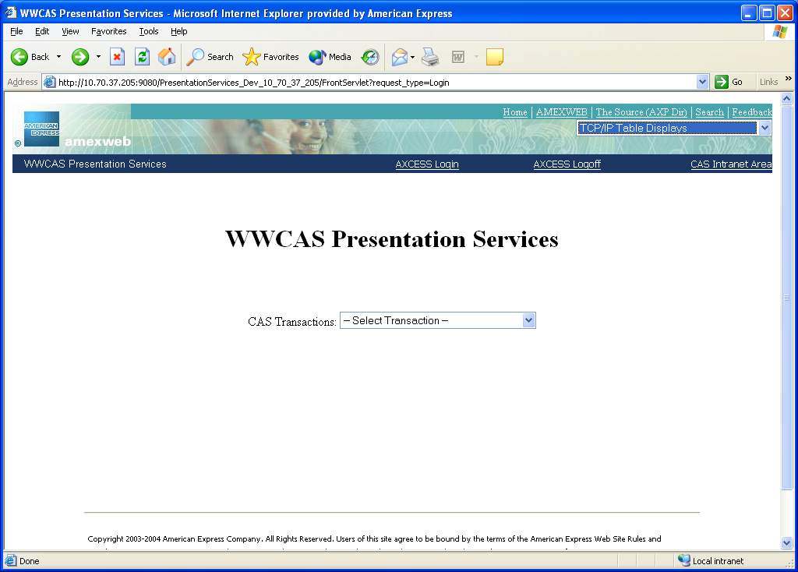
Presentation Services – Initial Screen

Slide 17
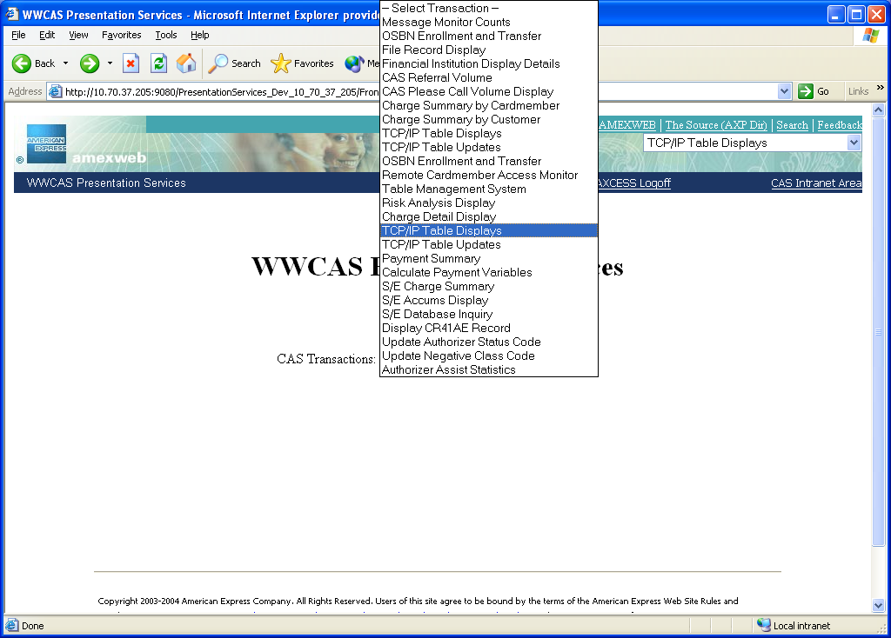
Presentation Services – Selection Screen

Slide 18
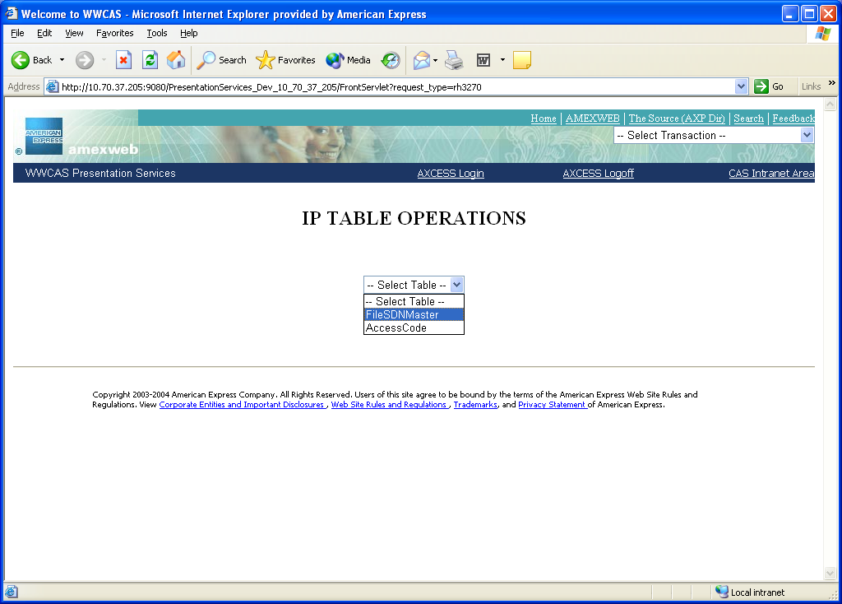
Presentation Services – IP Menu

Slide 19
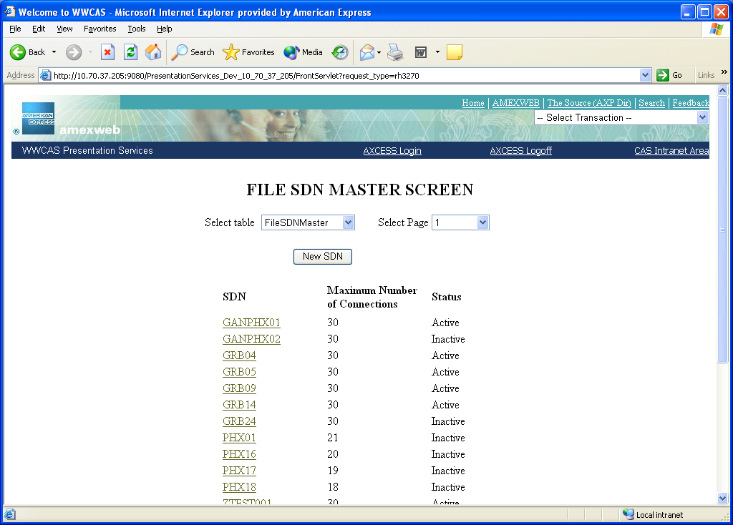
Presentation Services – File SDN Screen

Slide 20
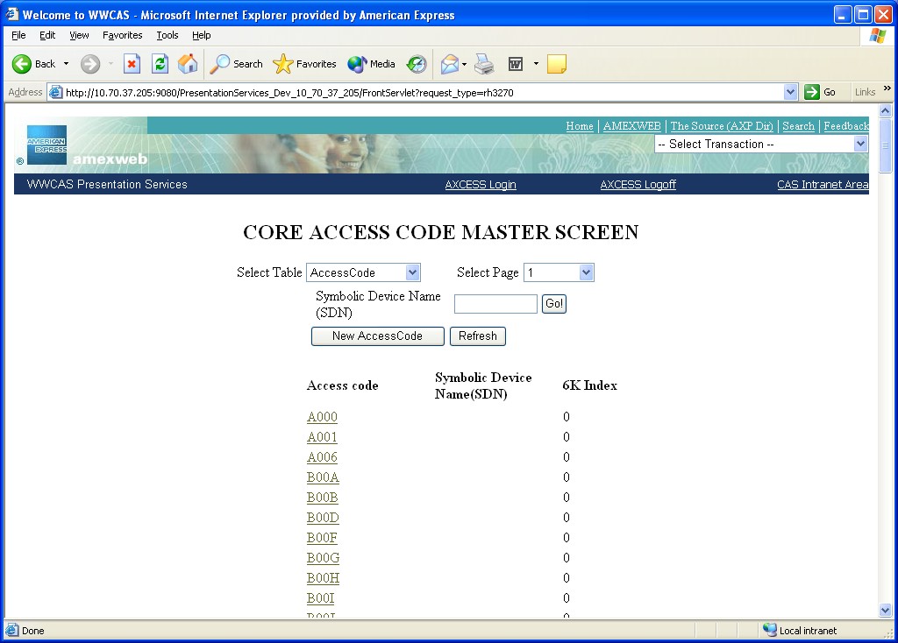
Presentation Services – Core Socket Table Screen

Slide 21
Cycle-up Modifications
HH80
CREMC
CREMC
DG70
DG71
DG70:
  Retrieves File SDN Master Table (record type = #MISU4, ordinal 88)
  Builds CIST (Core Index Socket Table) in USAT CIS
  Builds CSDT (Core Socket Detail Table) in USAT CSD
DG71
  Retrieves File Access Code Table (record type = #LY2Y2, ordinals 0-100)
  Builds Access Code Core Table

Slide 22
Packets and Messages
TCP/IP uses data streams, not messages.
A PACKET is a transmitted block of data.
The size of a packet will vary from device to device; communication will use the smallest size that is acceptable to either device.
A MESSAGE is all the data that was being sent.
A MESSAGE might be transmitted via more than one PACKET.
TCP OPZERO is responsible for assembling packets into a complete message.

Slide 23
Packets and Messages, Cont.
Note: since a message can be split between packets, string searches in a packet might not catch the desired message (if the string spans more than one packet).

Slide 24
PORT, SOCKET & CONNECTION
A PORT is a computer’s internal address relating an application to the Transport Layer.
A SOCKET is the concatenation of a computer’s IP address and a PORT.
A CONNECTION is between two computers that have exchanged SOCKET information (source socket and destination socket) and are actively communicating with each other.

Slide 25
Establishing a Connection
Server is started by issuing a socket call to create a socket – this socket is not yet associated with any other device
Client is started by issuing a socket call to create a socket – this socket is not yet associated with any other device
Server issues a “bind” call to a local address to be positioned for a subsequent connection
Server issues a “listen” function, waiting for a connection from the client
A “connect call” from the client will put the socket in a connected state
Server issues an “accept” call to accept the connection
Socket is ready to transmit/receive data

Slide 26
High-level Message Flow
IP Authorization message is received in the TCP/IP buffer.
TPF Socket API reads and assembles IP packets into an AM0SG input message on D0.
TPF socket API enters the links IP front end – YY00.
Links IP front end validates the access code and routes the message to the message parsing routine – RA6x (existing message processor).
Message is passed through links processing routines.
TPF links IP back-end builds the output message.
Response is sent back via the same IP socket which it was received. The exception to this rule is when something has happed with that socket; in this case, processing will use another in-use socket for that SDN.

Slide 27
RCPL for SNA & TCP/IP
RCPL for SNA
RID
(3 bytes)
CPU Id
(1 byte)
Destination
(4 bytes)
Terminal
Type (1 byte)
Non-SNA
Indicator is OFF
RCPL for TCP/IP
SDN Index
(2 bytes)
SD Index
(1 byte)
CPU Id
(1 byte)
Destination
(4 bytes)
Terminal
Type (1 byte)
Non-SNA
Indicator is ON

Slide 28
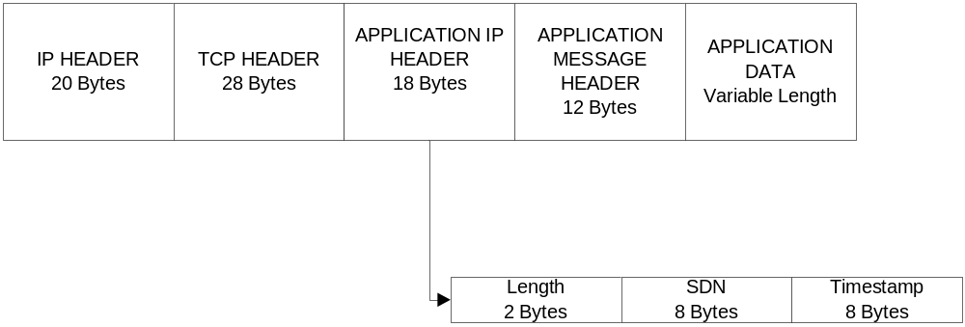
Message Format in TCP/IP
Only AMEX ISO 8583 messages will be tested and supported.
Other messages will require additional testing/modifications.

Slide 29
Segment Modifications
TQ65 – Display MP1 (field L6KMP1, in macro L6K6K) indicators for LDT (Link Directory Table) entries
TQ66 – Update MP1 indicators in the LDT
RA61 – check if TCP/IP is enabled for the message
    L6KMP1+1, bit 5 on == TCP/IP enabled

Slide 30
Segment Modifications, Cont.
DU71
  New Segment
  This is the Socket Middleware for inbound TCP/IP messages.
  Activated by an AORL, Activate On Receipt with Length

Slide 31
TCP/IP Middleware - Inbound
INETD
DU71
DU72
DN72
Activate_on_receipt_of_TCP_message
Inputs:
R1-> CE1CR0 == AM0SG
R2->EBW000 == RCPL
R4->CE1CRF == SPA
YY00
DU71:
  Activated via tpf_fork() from INETD
  Opens a socket to receive requests
  Creates and binds a socket
  Listens to any socket clients
  Always running
DU72:
  Reads a data packet
  Builds message in AM0SG format
DN72:
  Update CSDT
  Build RCPL in EBW000
  For errors, closes a socket and removes it from the CSDT

Slide 32
Links Inbound Application
YY00
CE1CR0 – AM0SG
CE1CRF – SPA
EBW000 - RCPL
CSNB
YY01
DV72
YH89
DN72
DN73
CSNB
  Get SNA SPA record
DV72
  Retrieve the SDN index (DN72)
  Validate the Access Code (DN73)
YH89
  SNA Message handler
YY01
  GAN Input Message Router
  TCP/IP Message handler

Slide 33
GAN Input Message Router
YY01
DN76
YH82
NB81
YH88
FA01
XG83
YH85
XA85
YH86
DN76 – Update the Access Code
NB81 – VR Input Message Count
XG83 – VR Input Router
YH85 – VOM POS
YH86 – VOM ATM
XA85 – CDN Input Router
FA01 – Express 3000
YH88 – Hardcopy
YH82 – Post Auth

Slide 34
SNA/TCP Output Message Flow
Non-TCP/IP output message processing routines
ZA81
YZ00
NB81
YZ03
DV72
ND80
DV71
ZA81 – Output message router
YZ00 – Output TCP/IP Message router
NB81 – counts (89/CNT entry)
YZ03 – Format Links message for TCP/IP Outbound
DV72 – If needed, creates a RCPL for the outbound message
ND80 – Message capture
DV71 – TCP/IP Outbound Middleware

Slide 35
Network Services Database
ZIPDB DISPlay – displays data about server applications
ZIPDB MESSages - displays message rates for server applications defined in the TCP/IP network services database.
ZIPDB RESet – resets the high-water mark values for backlog connections, application message rates and socket message rates.
ZIPDB REFresh – refreshes the core copy of the TCP/IP network services database from the /etc/services file. Changes take place immediately.

Slide 36
ZIPDB Entry
ZIPDB—DISPlay
MESSages
RESet
REFresh
Options for DISPlay, MESSages & RESet:
NAME-servername
PORT-serverport PROTocol-serverprotocol
ALL
Options for REFresh: none

Slide 37
ZIPDB Entry, continued
NAME-servername: specifies the name of the server application as defined in the TCP/IP network services database.
PORT-serverport: specifies the port that is used by the server application that is defined in the TCP/IP network services database.
PROTocol-serverprotocol: specifies the protoco that is used by the server application that is defined in the TCP/IP network services database.
ALL: all TCP/IP network services database entries are processed.

Slide 38
ZIPDB DISPLAY Example 1
13:44:48 ZIPDB DISP ALL
13:44:48 CSMP0099I 13.44.47 010000-L ZIPDB DISP ALL
13:44:48 IPDB0003I 13.44.47 NETWORK SERVICES DATABASE DISPLAY
13:44:48 APPLICATION PORT PROTOCOL WEIGHT TOS APPLRATE SOCRATE
13:44:48 ----------- ----- -------- ------ --- -------- -------
13:44:48 RIP 520 UDP 50
13:44:48 ECHO 7 TCP 100 5 250
13:44:48 DAYTIME 13 TCP 100 5 250
13:44:48 FTP 20 TCP 100 34
13:44:48 SNMP 161 UDP 50
13:44:48 MQISCFA 3000 TCP 100 5 2000 2000
13:44:49 STRA1 6600 TCP 100 4 400 50
13:44:49 STRA2 6700 TCP 100 4 400 50
13:44:49 STRA3 6800 TCP 100 4 400 50
13:44:49 STRA4 7600 TCP 100 4 400 50
13:44:49 STRA5 7700 TCP 100 4 400 50
13:44:49 STRA6 7800 TCP 100 4 400 50
13:44:49 END OF DISPLAY

Slide 39
ZIPDB Display Example 2
ZIPDB DISP NAME-STRA2
CSMP0099I 13.25.16 010000-L ZIPDB DISP NAME-STRA2
IPDB0003I 13.25.16 NETWORK SERVICES DATABASE DISPLAY
NAME- STRA2 PORT- 6700 PROTOCOL-TCP
WEIGHT- 100 TOS- 4 SOCRATE- 50
DEFINED APPLRATE LIMIT 400
CURRENT APPL MESSAGE RATE 0
HIGHEST APPL MESSAGE RATE 66
NUMBER TIMES LIMIT REACHED 0
CONNECTIONS INBOUND OUTBOUND
----------- ---------- ----------
MAXCONN DEF 100 100
CURRENT 4 0
HIGHEST 4 0
REJECTED 0 0
IP - ANY
-------------------- ----------
DEFINED 100
CURRENT 0
HIGHEST 2

Slide 40
ZIPDB MESSAGES Display
ZIPDB MESSAGES ALL
IPDB0004I 09.46.45 BEGIN PROCESSING MESSAGE RATES
IPDB0005I 09.46.50 MESSAGE RATES FOR A 5-SECOND INTERVAL
INPUT INPUT INPUT OUTPUT OUTPUT OUTPUT
APP NAME PORT MSG/SEC PKT/SEC BYTES/SEC MSG/SEC PKT/SEC BYTES/SEC
---------- ----- ------- ------- ---------- ------- ------- ----------
RIP 520 0 0 8 0 0 0
ECHO 7 0 0 0 0 0 0
DAYTIME 13 0 0 0 0 0 0
FTP 20 0 0 0 0 0 0
SNMP 161 0 0 0 0 0 0
MQISCFA 3000 0 0 0 0 0 0
STRA1 6600 0 0 0 0 0 0
GAN 6700 0 0 0 0 0 0
STRA3 6800 0 0 0 0 0 0
STRA4 7600 0 0 0 0 0 0
STRA5 7700 0 0 0 0 0 0
STRA6 7800 0 0 0 0 0 0
OTHER 0 0 0 0 0 0
---------- ----- ------- ------- ---------- ------- ------- ----------
TOTAL 0 0 8 0 0 0
END OF DISPLAY

Slide 41
ZIPDB MESSAGE NAME-
ZIPDB MESSAGE NAME-GAN
IPDB0004I 09.51.05 BEGIN PROCESSING MESSAGE RATES
IPDB0005I 09.51.09 MESSAGE RATES FOR A 5-SECOND INTERVAL
INPUT INPUT INPUT OUTPUT OUTPUT OUTPUT
APP NAME PORT MSG/SEC PKT/SEC BYTES/SEC MSG/SEC PKT/SEC BYTES/SEC
---------- ----- ------- ------- ---------- ------- ------- ----------
GAN 6700 0 0 0 0 0 0
END OF DISPLAY

Slide 42
ZIPTR – Display IP Trace Table
ZIPTR ALL
IPTR0001I 12.18.14 IP TRACE TABLE
RW IN SOURCE IP DEST IP SPORT DPORT PR FG DATA
02 D1 10.070.041.135 148.173.210.049 2772 20 06 10 40404040404040
02 D1 10.070.041.135 148.173.210.049 2772 20 06 10 00000000000000
02 D1 10.070.041.135 148.173.210.049 2772 20 06 18 40404040D4E2C7
02 D1 10.070.041.135 148.173.210.049 2772 20 06 10 00000000000000
01 D1 148.173.210.049 10.070.041.135 20 2772 06 10
02 D1 10.070.041.135 148.173.210.049 2772 20 06 10 D4E2C74040F1F3
02 D1 10.070.041.135 148.173.210.049 2772 20 06 10 F4F0F540002340
01 D1 148.173.210.049 10.070.041.135 20 2772 06 10
02 D1 10.070.041.135 148.173.210.049 2772 20 06 19 40F8F3F1000000
01 D1 10.064.249.049 10.064.249.001 0 0 01 00 0800CB2C0A40F9
01 D1 148.173.210.049 10.070.041.135 20 2772 06 10
01 D1 148.173.210.049 10.070.041.135 21 2678 06 18 32323620547261
01 D1 148.173.210.049 10.070.041.135 20 2772 06 11
02 D1 10.064.249.001 10.064.249.049 0 0 01 00 0000D32C0A40F9
02 D1 10.070.041.135 148.173.210.049 2772 20 06 10
02 D1 10.070.041.135 148.173.210.049 2678 21 06 18 5057440D0A
MORE DATA AVAILABLE, ENTER ZPAGE TO CONTINUE

Slide 43
ZIPTR – Formatted Display
ZIPTR 2 FORMAT
IPTR0002I 12.17.03 IP FORMATTED TRACE
RWI-01 IPCCW-D1 SOURCE IP-148.173.210.49 DEST IP-148.173.245.212 LEN-48
TOD-BCA7DC2407445D80 PROTOCOL-06 (TCP) SOURCE PORT-6700 DEST PORT-57629
SEQ-3258823331 ACK-1676312897 WINDOW-2047 URGENT OFFSET-0
TCP FLAG BYTE-12 (ACK, SYN)
IP HEADER 45040030 EC840000 3C06A0DE 94ADD231 94ADF5D4
TCP HEADER 1A2CE11D C23DB2A3 63EA8141 701207FF 355C0000 020405AC 01030304
RWI-02 IPCCW-D1 SOURCE IP-148.173.245.212 DEST IP-148.173.210.49 LEN-40
TOD-BCA7DC2407448CC0 PROTOCOL-06 (TCP) SOURCE PORT-57629 DEST PORT-6700
SEQ-1676312897 ACK-3258823332 WINDOW-5840 URGENT OFFSET-0
TCP FLAG BYTE-10 (ACK)
IP HEADER 45000028 A8D34000 3A06A69B 94ADF5D4 94ADD231
TCP HEADER E11D1A2C 63EA8141 C23DB2A4 501016D0 524B0000
752 ENTRIES IN IP TRACE TABLE

Slide 44
ZINET: Display Servers
ZINET DISP S-*
INET0032I 12.22.25 START OF ZINET DISPLAY OF ACTIVE SERVERS
SERVER PROTO PORT PGM IP SOCKET COUNT
FTPD TCP 00021 CFTP ANY 12582914/00C00002 0000000002
SYSLOGD 00000 CSYL ANY 00000000/00000000 0000000005
AORSRV1 00000 DU71 ANY 00000000/00000000 0000000001
AORSRV2 00000 DU71 ANY 00000000/00000000 0000000001
AORSRV3 00000 DU71 ANY 00000000/00000000 0000000001
MQS TCP 03000 CMQL ANY 12583008/00C00060 0000000001
END OF DISPLAY

Slide 45
ZFILT: Filter Rules Display
ZFILT DISP
FILT0001I 12.28.44 DISPLAY PACKET FILTERING RULES
RULE ACTION REMOTE NETWORK PORT PROTO ICMPTYPE PACKETS
---- ------ ------------------ ----- ----- -------- ----------
1 DENY 137 0
2 DENY 445 0
3 ALLOW 148.173.245.0/24 6700 334
DEF ALLOW 2218
END OF DISPLAY

Slide 46
ZTTCP: Display Stats
ZTTCP DISP STATS
TTCP0182I 12.44.58 BEGIN ZTTCP STATS DISPLAY
NUMBER CURRENT MAXIMUM MAX IN MAX IN
DEFINED IN USE IN USE USE DATE USE TIME
SOCKET BLOCK ENTRIES 1000 19 21 03MAR 12.05.56
IP MESSAGE TABLE BLOCKS 4000 0 9 03MAR 11.50.08
6948 IP PACKETS SENT
22956 IP PACKETS RECEIVED
0 CHECKSUM ERRORS DETECTED
0 IP FRAGMENTS RECEIVED
0 TCP MESSAGES RECEIVED OUT OF ORDER
0 TCP MESSAGES RETRANSMITTED DUE TO TIMEOUT
0 TCP MESSAGES FAST RETRANSMITTED
0 TCP SOCKETS CLEANED UP BECAUSE OF RETRANSMIT TIMEOUTS
END OF ZTTCP DISPLAY

Slide 47
ZTTCP: Display all IP Routers & OSA Express Connections
ZTTCP DISP ALL
TTCP0184I 12.48.30 IP CONNECTIONS DISPLAY
CURRENT DESIRED
OSA NAME STATUS STATUS LOCAL IP ADDR TRACE READ DATA
-------- ------ ------ --------------- ----- ---- ----
OSA1PRIM ACTIVE ACTIVE 10.064.249.049 ALL 7128 7127
END OF DISPLAY

Slide 48
89/CNT/LKIP
89/cnt/lkip
TIME: 15.14.39 DATE: 05.028
MESSAGE MONITOR COUNTING
LKIP TCP/IP COUNTERS
TYPE COUNT TYPE COUNT
DU72 IP REQUESTS .......0 ......(SPARE)...... .......0
DV71 IP REPLYS .......0 ......(SPARE)...... .......0
DU72 IP RECEIVES ......72 ......(SPARE)...... .......0
DV71 IP SENDS .......0 ......(SPARE)...... .......0
DU72 IP REQUEST ERR .......0 ......(SPARE)...... .......0
DV71 IP REPLY ERR .......0
DV71 IP SEND ERR .......0
DU72 IP RECEIVE ERR ......79
DU71 AOR ERROR .......0
DN73 SOCKET NOT FND .......0
DN73 SOCKET DELETED .......0
DN73 SDN NOT FOUND .......0
YZ00 INDEX_SPA .......0
YZ00 INDEX_CDN .......0
YZ00 INDEX_BUILD .......0
ZH82 INDEX_ZH82 .......0
......(SPARE)...... .......0
......(SPARE)...... .......0
<ENTER>-REFRESH PF3 - EXIT PF8 - NEXT SYSTEM ACTIVE

